Slide 1
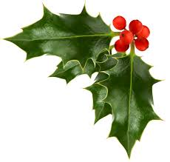
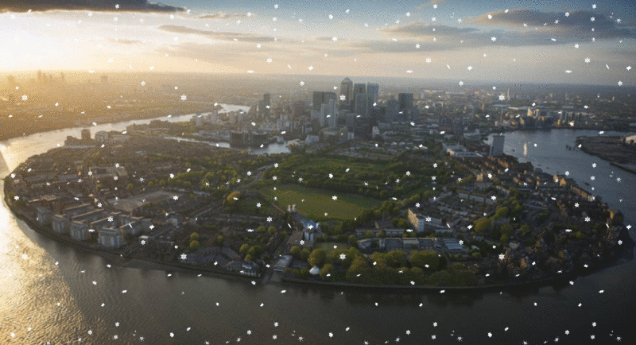
Welcome to City of Peace Community Church

Slide 2
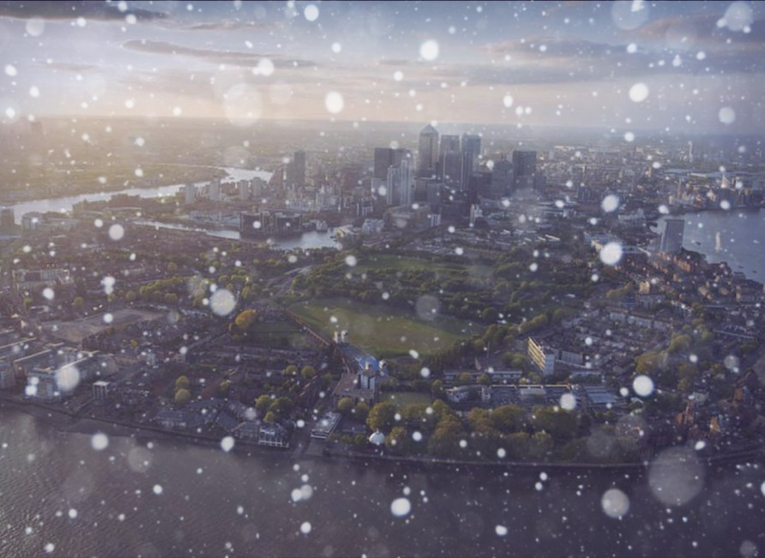
Welcome to City of Peace Community Church

Slide 3
Notes:
O Lord My God ( verse 1 ) 1/5

Slide 4
Call to Worship
Notes:
O Lord My God ( verse 1 ) 1/5

Slide 5
Notes:
O Lord My God ( verse 1 ) 1/5

Slide 6
Hark the herald angels sing“
Glory to the newborn King!
Peace on earth and mercy mild
God and sinners reconciled“
Joyful, all ye nations rise
Join the triumph of the skies
With the angelic host proclaim:
"Christ is born in Bethlehem“
Hark! The herald angels sing“
Glory to the newborn King!"

Slide 7
Christ by highest heav'n adored
Christ the everlasting Lord!
Late in time behold Him come
Offspring of a Virgin's womb
Veiled in flesh the Godhead see
Hail the incarnate Deity
Pleased as man with man to dwell
Jesus, our Emmanuel
Hark! The herald angels sing
"Glory to the newborn King!"

Slide 8
Hail the heav'n-born Prince of Peace!
Hail the Son of Righteousness!
Light and life to all He brings
Ris'n with healing in His wings
Mild He lays His glory by
Born that man no more may die
Born to raise the sons of earth
Born to give them second birth
Hark! The herald angels sing
"Glory to the newborn King!"

Slide 10
Joy to the World
Joy to the World , the Lord is come!
Let earth receive her King;
Let every heart prepare Him room,
And Heaven and nature sing,
And Heaven and nature sing,
And Heaven, and Heaven, and nature sing.

Slide 11
Joy to the World, the Saviour reigns!
Let men their songs employ;
While fields and floods, rocks, hills and plains
Repeat the sounding joy,
Repeat the sounding joy,
Repeat, repeat, the sounding joy.

Slide 12
No more let sins and sorrows grow,
Nor thorns infest the ground;
He comes to make His blessings flow
Far as the curse is found,
Far as the curse is found,
Far as, far as, the curse is found.

Slide 13
He rules the world with truth and grace,
And makes the nations prove
The glories of His righteousness,
And wonders of His love,
And wonders of His love,
And wonders, wonders, of His love.

Slide 15
In the bleak midwinter, frosty wind made moan,
earth stood hard as iron, water like a stone;
snow had fallen, snow on snow, snow on snow,
in the bleak midwinter, long ago.

Slide 16
Our God, heaven cannot hold him, nor earth sustain;
heaven and earth shall flee away
when he comes to reign.
In the bleak midwinter a stable place sufficed
the Lord God Almighty, Jesus Christ.

Slide 17
Angels and archangels may have gathered there,
cherubim and seraphim thronged the air;
but his mother only, in her maiden bliss,
worshiped the beloved with a kiss.

Slide 18
What can I give him, poor as I am?
If I were a shepherd, I would bring a lamb;
if I were a Wise Man, I would do my part;
yet what I can I give him: give my heart.

Slide 20
Oh Holy Night
Oh holy night
The stars are brightly shining
It is the dawn of our dear saviours birth
Long lay the world
In sin and e'er pining
To he appeared and the souls felt itd worth

Slide 21
A thrill of hope the weary world rejoices
For yonder breaks a new and glorious dawn
Fall on your knees
Oh hear the Saviour voice
Oh night divine
Oh night, when Christ was born
Oh night, divine
Oh night, oh night divine

Slide 22
Led by the light
of Faith serenely beaming,
With glowing hearts by His cradle we stand.
So led by light
of a star sweetly gleaming,
Here came the wise men from Orient land.

Slide 23
The King of Kings lay thus in lowly manger;
In all our trials born to be our friend
He knows our need,
to our weakness is no stranger,
Behold your King! Before Him lowly bend!
Behold your King! Before Him lowly bend!

Slide 24
Truly He taught us
to love one another;
His law is love and His gospel is peace.
Chains shall He break
for the slave is our brother;
And in His name all oppression shall cease.

Slide 25
Sweet hymns of joy
in grateful chorus raise we,
Let all within us praise His holy name.
Christ is the Lord!
O praise His Name forever,
His power and glory evermore proclaim.
O night divine,
O night,
O night divine

Slide 27
O Come All Ye FaithfulJoyful and triumphant
O come ye, O come ye to Bethlehem
Come and behold Him,Born the King of Angels
O come, let us adore Him,
O come, let us adore Him,
O come, let us adore Him,Christ the Lord.

Slide 28
God of God light of light
Lo he not the virgin's womb;
Very God Begotten not created:
O come, let us adore Him,
O come, let us adore Him,
O come, let us adore Him,Christ the Lord.

Slide 29
Sing, choirs of angels,Sing in exultation,
Sing all ye citizens of heaven above
Glory to God, in the Highest;
O come, let us adore Him,
O come, let us adore Him,
O come, let us adore Him,Christ the Lord.

Slide 30
Yea, Lord, we greet Thee,
Born this happy morning,
Jesus to thee be glory given
Word of the Father, now in flesh appearing;
O come, let us adore Him,
O come, let us adore Him,
O come, let us adore Him, Christ the Lord.

