Slide 1
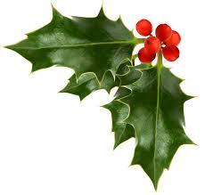
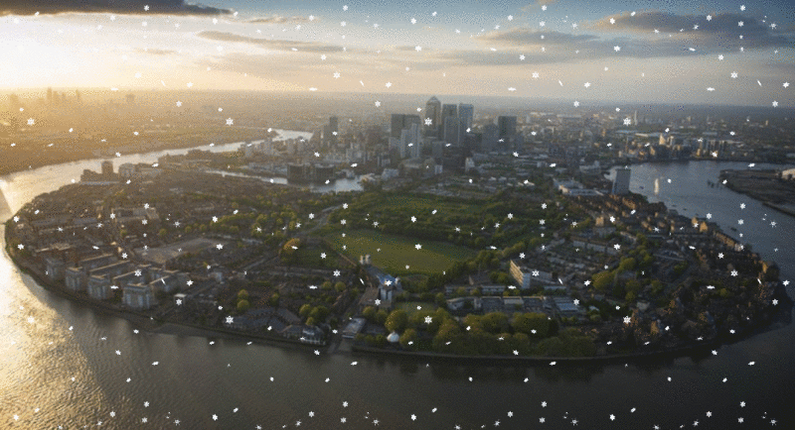
Welcome to City of Peace Community Church

Slide 2
Notes:
O Lord My God ( verse 1 ) 1/5

Slide 3
Oh come all ye faithful
Oh come all ye faithful Joyful and triumphant Oh come ye, oh come ye to Bethlehem
Come and behold him
Born the king of angels
Oh come let us adore Him Oh come let us adore Him Oh come let us adore Him, Christ the Lord!
Notes:
O Lord My God ( verse 1 ) 1/5

Slide 4
God of God light of light Lo he abhors not the virgin's womb; Very God, begotten not created: O come let us adore him Christ the Lord.
Oh come let us adore Him Oh come let us adore Him Oh come let us adore Him, Christ the Lord!
Notes:
O Lord My God ( verse 1 ) 1/5

Slide 5
Sing, choirs of angels,
Sing in exultation,
Sing, all ye citizens of heaven above;
Glory to God
In the highest:
Oh come let us adore Him Oh come let us adore Him Oh come let us adore Him, Christ the Lord!
Notes:
O Lord My God ( verse 1 ) 1/5

Slide 6
Notes:
O Lord My God ( verse 1 ) 1/5

Slide 7
O little town of Bethlehem
O little town of Bethlehem
How still we see thee lie
Above thy deep and dreamless sleep
The silent stars go by
Yet in thy dark streets shineth
The everlasting Light
The hopes and fears of all the years
Are met in thee tonight
Notes:
O Lord My God ( verse 1 ) 1/5

Slide 8
O morning stars together
Proclaim the holy birth
And praises sing to God the King
And Peace to men on earth
For Christ is born of Mary
And gathered all above
While mortals sleep, the angels keep
Their watch of wondering love
Notes:
O Lord My God ( verse 1 ) 1/5

Slide 9
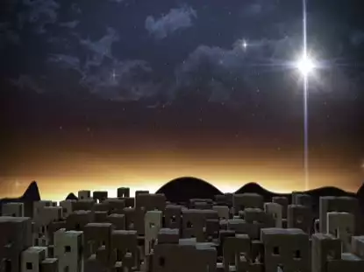
Instrumental Verse
Notes:
O Lord My God ( verse 1 ) 1/5

Slide 10
How silently, how silently
The wondrous gift is given!
So God imparts to human hearts
The blessings of His heaven.
No ear may hear His coming,
But in this world of sin,
Where meek souls will receive him still,
The dear Christ enters in.
Notes:
O Lord My God ( verse 1 ) 1/5

Slide 11
O holy Child of Bethlehem
Descend to us, we pray
Cast out our sin and enter in
Be born to us today
We hear the Christmas angels
The great glad tidings tell
O come to us, abide with us
Our Lord Emmanuel
Notes:
O Lord My God ( verse 1 ) 1/5

Slide 12
Notes:
O Lord My God ( verse 1 ) 1/5

Slide 13
Away in a manger
Away in a manger
No crib for His bed
The little Lord Jesus
Lay down His sweet head
The stars in the sky
Look down where He lay
The little Lord Jesus
Asleep on the hay
Notes:
O Lord My God ( verse 1 ) 1/5

Slide 14
The cattle are lowing
The poor Baby wakes
But little Lord Jesus
No crying He makes
I love Thee, Lord Jesus
Look down from the sky
And stay by my side
'Til morning is nigh
Notes:
O Lord My God ( verse 1 ) 1/5

Slide 15
Be near me, Lord Jesus
I ask Thee to stay
Close by me forever
And love me, I pray
Bless all the dear children
In Thy tender care
And take us to Heaven
To live with Thee there
Notes:
O Lord My God ( verse 1 ) 1/5

Slide 16
Notes:
O Lord My God ( verse 1 ) 1/5

Slide 17
Joy to the World
Joy to the World , the Lord is come!
Let earth receive her King;
Let every heart prepare Him room,
And Heaven and nature sing,
And Heaven and nature sing,
And Heaven, and Heaven, and nature sing.

Slide 18
Joy to the World, the Saviour reigns!
Let men their songs employ;
While fields and floods, rocks, hills and plains
Repeat the sounding joy,
Repeat the sounding joy,
Repeat, repeat, the sounding joy.

Slide 19
No more let sins and sorrows grow,
Nor thorns infest the ground;
He comes to make His blessings flow
Far as the curse is found,
Far as the curse is found,
Far as, far as, the curse is found.

Slide 20
He rules the world with truth and grace,
And makes the nations prove
The glories of His righteousness,
And wonders of His love,
And wonders of His love,
And wonders, wonders, of His love.

Slide 22
Silent Night
Silent night, holy night!
All is calm, all is bright. Round yon Virgin, Mother and Child. Holy infant so tender and mild, Sleep in heavenly peace, Sleep in heavenly peace

Slide 23
Silent night, holy night! Shepherds quake at the sight. Glories stream from heaven afar Heavenly hosts sing Alleluia, Christ the Saviour is born! Christ the Saviour is born

Slide 24
Silent night, holy night! Son of God love's pure light. Radiant beams from Thy holy face With dawn of redeeming grace, Jesus Lord, at Thy birth Jesus Lord, at Thy birth

Slide 26
Joy to the World
Joy to the World , the Lord is come!
Let earth receive her King;
Let every heart prepare Him room,
And Heaven and nature sing,
And Heaven and nature sing,
And Heaven, and Heaven, and nature sing.

Slide 27
Joy to the World, the Saviour reigns!
Let men their songs employ;
While fields and floods, rocks, hills and plains
Repeat the sounding joy,
Repeat the sounding joy,
Repeat, repeat, the sounding joy.

Slide 28
No more let sins and sorrows grow,
Nor thorns infest the ground;
He comes to make His blessings flow
Far as the curse is found,
Far as the curse is found,
Far as, far as, the curse is found.

Slide 29
He rules the world with truth and grace,
And makes the nations prove
The glories of His righteousness,
And wonders of His love,
And wonders of His love,
And wonders, wonders, of His love.

